Slide 1
Principles of Economics
Final termTopic 2
Measuring the Cost of Living – Consumer Price Index (CPI)

Slide 2
THE CONSUMER PRICE INDEX
The consumer price index (CPI) is a measure of the overall cost of the goods and services bought by a typical consumer.
CPI is used to monitor changes in the cost of living over time.

Slide 3
THE CONSUMER PRICE INDEX
When the CPI rises, the typical family has to spend more money to maintain the same standard of living.

Slide 4
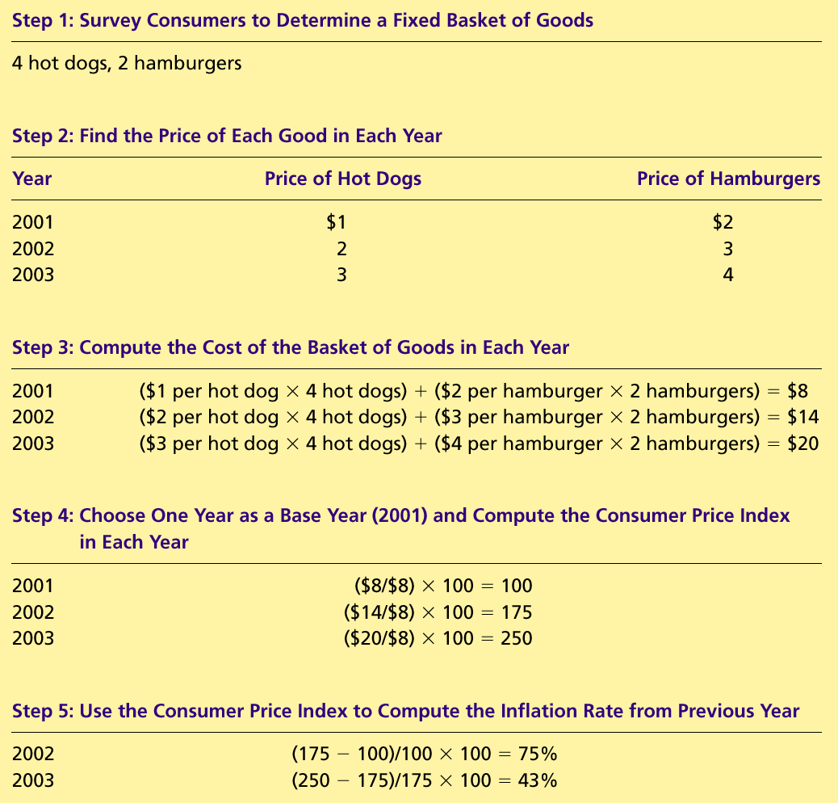
How the Consumer Price Index Is Calculated
Fix the Basket: Determine what prices are most important to the typical consumer.
  The Economic Agency identifies a basket of goods and services the typical consumer buys.

Slide 5
How the Consumer Price Index Is Calculated
Find the Prices: Find the prices of each of the goods and services in the basket for each point in time.

Slide 6
How the Consumer Price Index Is Calculated
Compute the Basket’s Cost: Use the data on prices to calculate the cost of the basket of goods and services at different times.

Slide 7
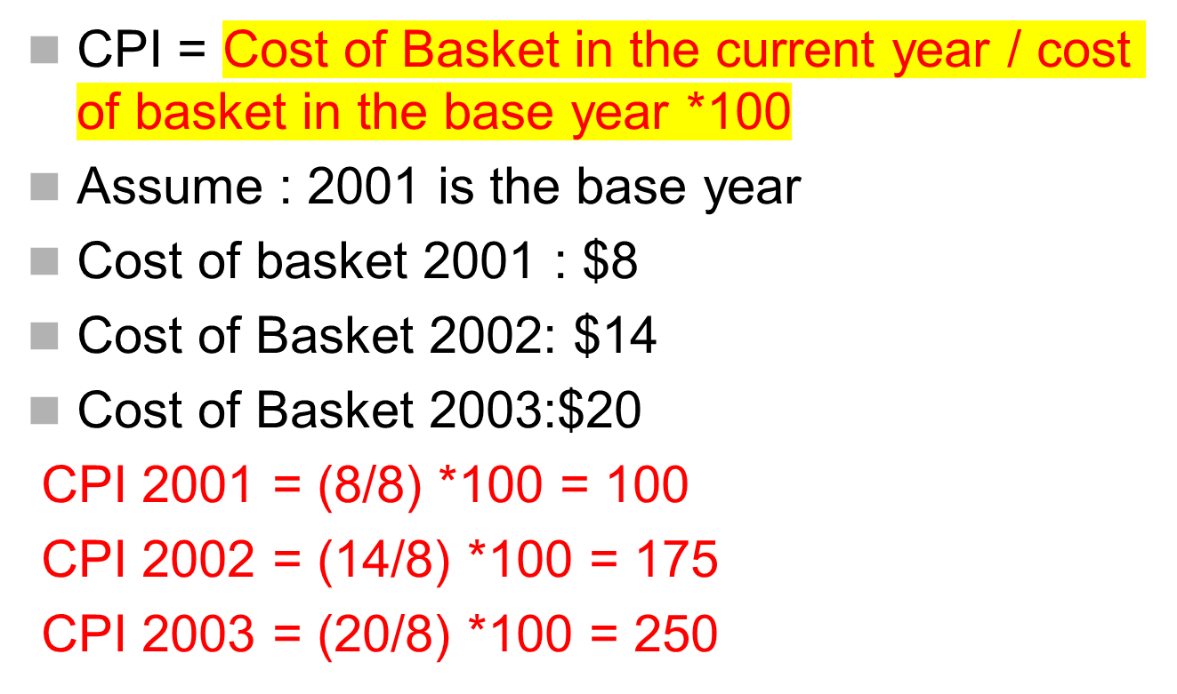

Slide 8
How the Consumer Price Index Is Calculated
Choose a Base Year and Compute the Index:
  Designate one year as the base year, making it the benchmark against which other years are compared.
  Compute the index by dividing the price of the basket in one year by the price in the base year and multiplying by 100.

Slide 9
How the Consumer Price Index Is Calculated
Compute the inflation rate: The inflation rate is the percentage change in the price index from the preceding period.

Slide 10
How the Consumer Price Index Is Calculated
The Inflation Rate
  The inflation rate is calculated as follows:

Slide 11
CPI Vs GDP deflator
GDP deflator & CPI give some what different information about what’s happening to the overall level of prices in the economy.
Three Key Differences:
GDP deflator measures the prices of all goods and services produced whereas CPI measures the prices of only the goods and services bought by consumers.
GDP deflator includes only those goods produced domestically. Imported goods are not a part of GDP and do not show up in the GDP deflator.
3. CPI include imported goods.CPI is computed using a fixed basket of goods whereas GDP deflator allows the basket of goods to change over time as the composition of goods and services changed

Slide 12
Problems in Measuring the Cost of Living- CPI Biases
The CPI is an accurate measure of the selected goods that make up the typical bundle, but it is not a perfect measure of the cost of living.

Slide 13
Problems in Measuring the Cost of Living
Substitution bias
Introduction of new goods

Slide 14
Problems in Measuring the Cost of Living- CPI Biases
Substitution Bias
  The basket does not change to reflect consumer reaction to changes in relative prices.
    Consumers substitute toward goods that have become relatively less expensive.
    The index overstates the increase in cost of living by not considering consumer substitution.

Slide 15
Problems in Measuring the Cost of Living
Introduction of New Goods
  The basket does not reflect the change in purchasing power brought on by the introduction of new products.
    New products result in greater variety, which in turn makes each dollar more valuable.
    Consumers need fewer dollars to maintain any given standard of living.

Slide 16
Problems in Measuring the Cost of Living- CPI Biases
The substitution bias, introduction of new goods, cause the CPI to overstate the true cost of living.
  The issue is important because many government programs use the CPI to adjust for changes in the overall level of prices.

Slide 17
Nominal & Real Interest rate
Real Interest rate = Nominal interest rate – Inflation rate
The nominal interest rate is the interest rate usually reported and not corrected for inflation.
  It is the interest rate that a bank pays.
The real interest rate is the nominal interest rate that is corrected for the effects of inflation.

Slide 18
INFLATION
Inflation refers to a situation in which the economy’s overall price level is rising.
The inflation rate is the percentage change in the price level from the previous period.
  Not all prices rise at the same rate during inflation.
  Not everyone suffers equally from inflation.
  Although inflation makes some people worse off, it makes some people better off
Hyperinflation is an extraordinarily high rate of inflation such as Germany experienced in the 1920s.
Hyperinflation is inflation that exceeds 50% per month

Slide 19
Types of Inflation
Demand-Pull Inflation
  Demand-pull inflation results from excessive pressure on the demand side of the economy.
  “Too much money chases too few goods” enabling producers to raise prices.
Cost-Push Inflation
  The pressure on price could also originate on the supply side.
  Higher production costs put upward pressure on product prices

Slide 20
Effects of Inflations [on..]
 | Consumers | Producers | Economy
Zero inflation | Not affected at all | No incentive to produce more, Same production | Stagnant for almost same level of production
Mild Inflation | Affected but not much, Demand may be same | Have incentive to produce more, Higher production | Economy expands as production increase
High Inflation | Affected much, Demand may be lower in many products | Producers of inelastic products affected, Production lower for lower demand | Economy squeezes as production falls

Slide 21
Summary
The consumer price index shows the cost of a basket of goods and services relative to the cost of the same basket in the base year.
The index is used to measure the overall level of prices in the economy.
The percentage change in the CPI measures the inflation rate.

Slide 22
Summary
The consumer price index is an imperfect measure of the cost of living for the following three reasons: substitution bias, and the introduction of new goods.

